Slide 1

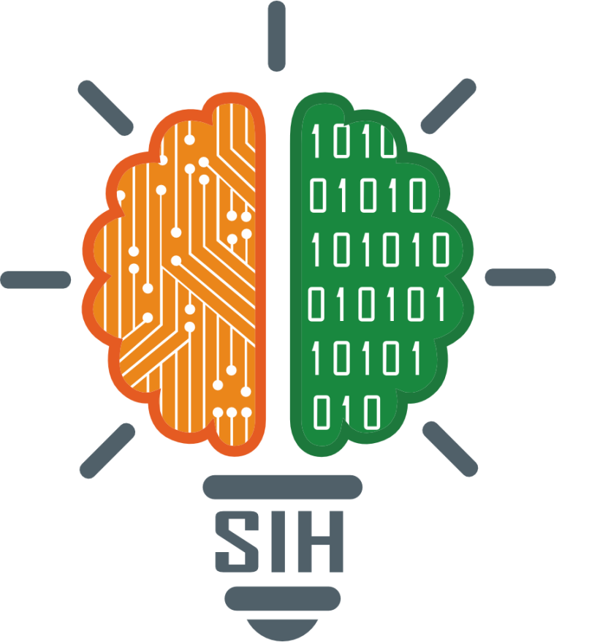
SMART INDIA HACKATHON 2025
SEHAT SYNC
Problem Statement ID – 25018
Problem Statement Title- Telemedicine Access for Rural Healthcare in Nabha
Theme- MedTech/ BioTech / HealthTech
PS Category- Software
Team ID-
Team Name- SEHAT SYNC

Slide 2
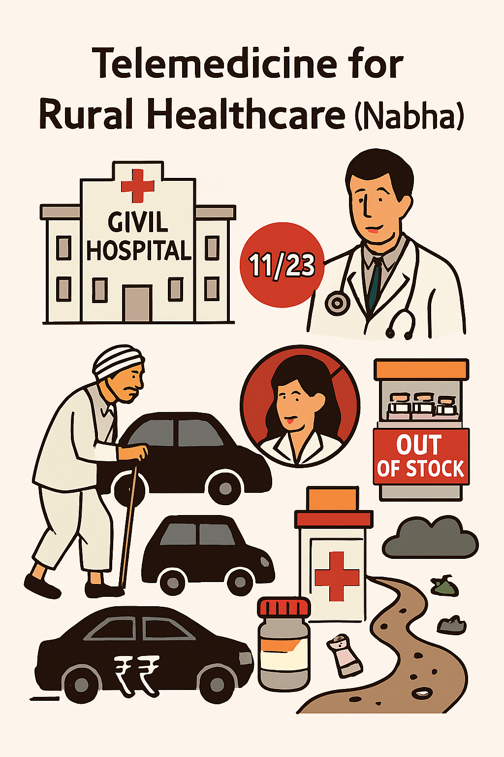
PROBLEM STATEMENT
SEHAT SYNC
Problem Overview:
Nabha’s Civil Hospital operates at <50% capacity (11/23 doctors), serving 173 villages. Patients travel long distances—often missing work—only to face unavailable specialists or out-of-stock medicines. Poor roads and sanitation worsen access, delaying care and increasing financial strain.
Why It Matters:
Thousands of rural residents, especially farmers and daily-wage earners, suffer preventable health issues and financial losses. Solving this improves healthcare delivery, reduces travel, and enhances community well-being.
Expected Outcomes:
Multilingual telemedicine app (Punjabi, Hindi, English)
Offline-accessible digital health records
Real-time medicine availability tracking
AI symptom checker for low-bandwidth areas
Scalable model for other rural regions
Stakeholders:
Rural patients
Nabha Civil Hospital staff
Punjab Health Department
Local pharmacies
Daily-wage workers & farmers
Supporting Data:
173 villages served by only 11 doctors
31% of rural Punjab households have internet access
Telemedicine adoption in India growing at 31% CAGR (2020–2025)

Slide 3
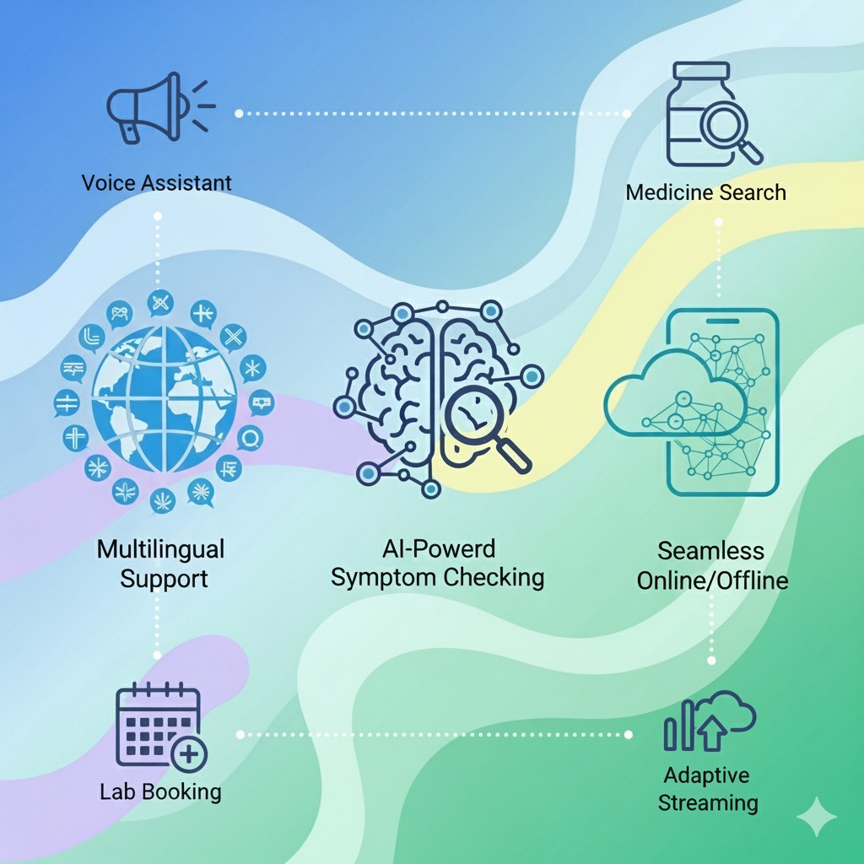
Telemedicine Access for Rural Healthcare
SEHAT SYNC
Proposed Solution
Detailed explanation:
A multilingual, inclusive, and offline-friendly mobile app that connects patients, doctors, and pharmacies—designed to overcome barriers like low literacy, poor connectivity, and limited medical infrastructure.
Inclusive Access: Supports Punjabi, Hindi, English; icon-based navigation; SMS/USSD for feature phones.
Offline Resilience: AI symptom checker, encrypted health records, and secure login work without internet.
Smart Connectivity: Adaptive streaming and incremental sync ensure smooth consultations and data safety.
Seamless Care: Real-time medicine tracker and integrated lab booking streamline treatment.
How it addresses the problem:
Language Barriers: Multilingual interface (Punjabi, Hindi, English)
Availability of smart phone: SMS/USSD support for feature phone users to book appointments and
report symptoms.
Adaptive Streaming: Ensures smooth consultations even with poor internet.
Offline Access: Stores encrypted health data for use without connectivity.
Limited Access to Doctors & Delayed Diagnosis: AI symptom checker provides instant triage and
guidance which can run offline
Medicine Unavailability & Wasted Travel: Real-time medicine tracker shows nearby availability based on
prescriptions
Secure Offline Login: Allows access to records even without internet.
Innovation and uniqueness of the solution:
Icon-driven navigation and voice assistant
Supports text and image-based medicine search
Lab appointment booking integrated post-consultation
Media quality dynamically adjusts to bandwidth
Syncs records in small encrypted chunks, avoiding failure in low-bandwidth zones

Slide 4
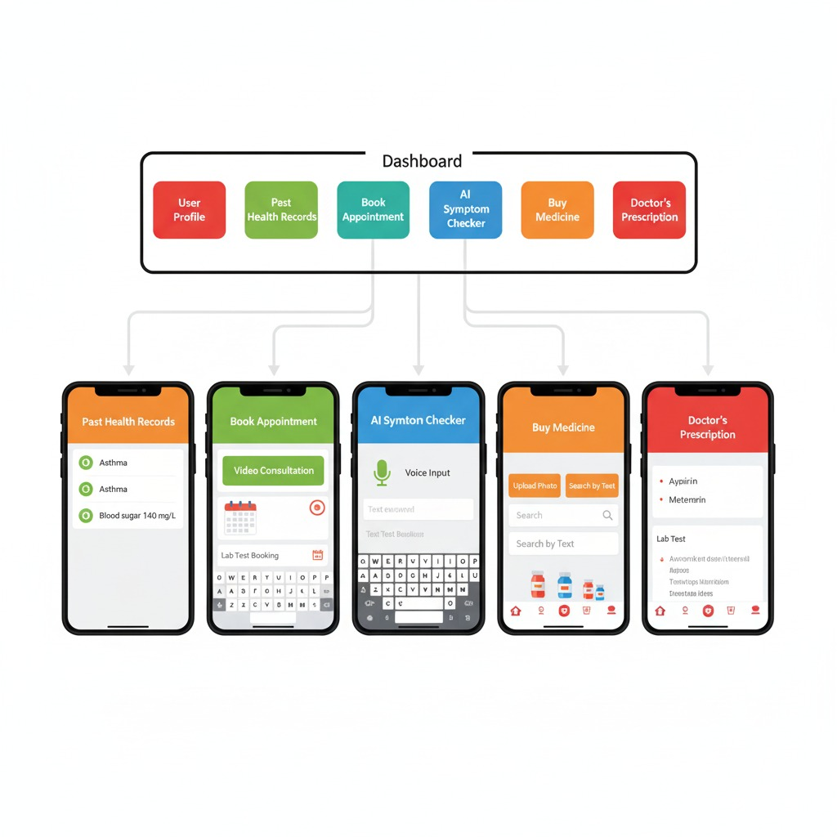
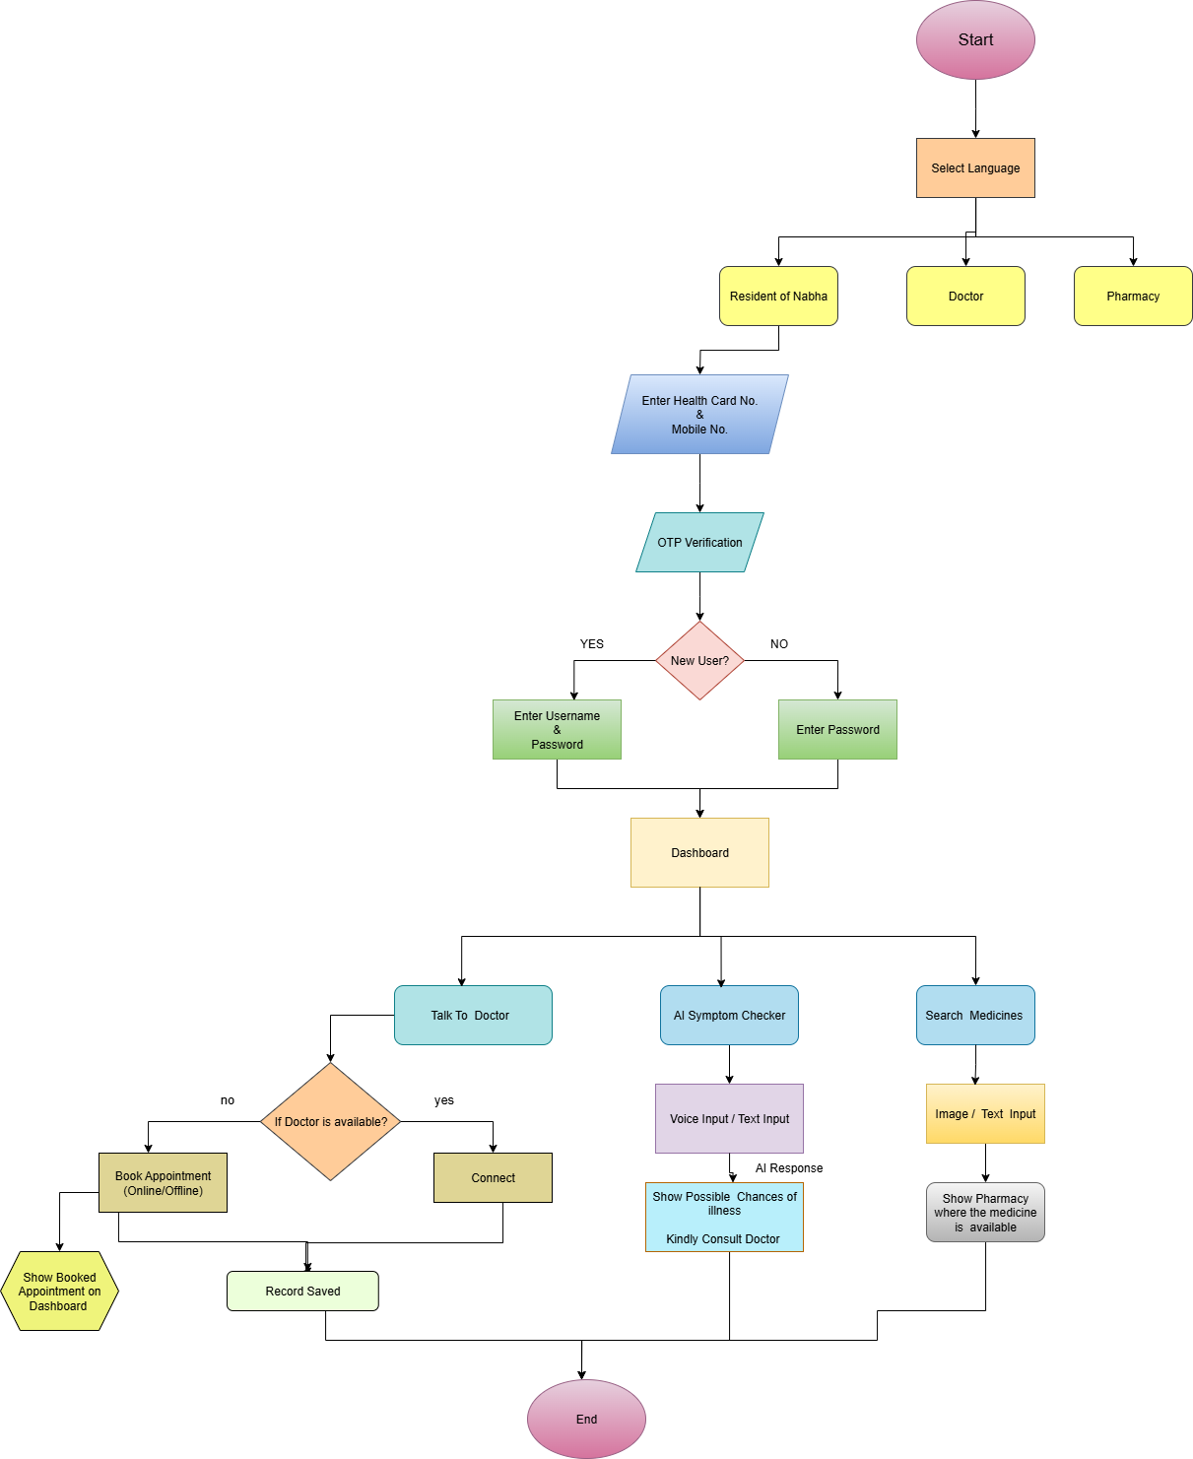
TECHNICAL APPROACH
SEHAT SYNC
Technologies to be used:
Mobile App (Frontend)
Built with Flutter: A single codebase for both Android and iOS
Intuitive UI: Icon-driven and multilingual in Punjabi, Hindi, and
English.
Voice I/O: speech_to_text for input, flutter_tts for audio feedback.
Offline Access: Caches encrypted patient data via sqflite/hive and flutter_secure_storage.
Telemedicine: Adaptive video/audio calls using flutter_webrtc.
User ID: Fast, secure identification via OTP generation.
Connectivity: Monitors status to switch between online/offline modes.
Backend & Cloud Services
Cloud Provider: Utilizes AWS.
Backend: RESTful APIs built with Node.js.
Databases:
SQL (PostgreSQL): For structured data.
NoSQL (MongoDB): For flexible patient health records.
AI & Communication:
Hybrid AI: TensorFlow Lite on-device for basic analysis; advanced models on the cloud.
Real-Time: MQTT(Message Queuing Telemetry Transport) for chat and notifications; SMS gateway for non-smartphone users.

Slide 5
FEASIBILITY AND VIABILITY
SEHAT SYNC
Feasibility
Social Impact: Directly targets rural healthcare gaps—literacy, connectivity, and access to medical services.
Technical Viability: Built on lightweight, proven technologies suited for low-resource environments: Flutter, SQLite, TensorFlow Lite, WebRTC, SMS APIs.
Scalability: Modular, offline-first architecture with SMS/USSD support enables deployment across diverse regions and device types.
Policy Fit: Aligns with India’s Ayushman Bharat Digital Mission (ABDM) and supports ABHA-linked health record access.
Category | Challenge | Strategy
Connectivity | Unstable internet | Adaptive streaming, progressive sync, offline access, SMS/USSD fallback
Digital Literacy | Navigation and input issues | Icon-driven UI, voice prompts, community onboarding
Device Access | Feature phones/shared devices | Full SMS/USSD support, kiosk-based access via health workers
Data Privacy | Risk of data misuse | AES-256 encryption, OTP login, user consent education
Doctor Availability | Limited rural doctors | AI triage for filtering, slot booking and reminders
Pharmacy & Lab Integration | Inconsistent updates | Lightweight APIs, SMS-based sync, provider incentives
AI Accuracy | Misclassification risk | Train on rural datasets, human review for flagged cases

Slide 6
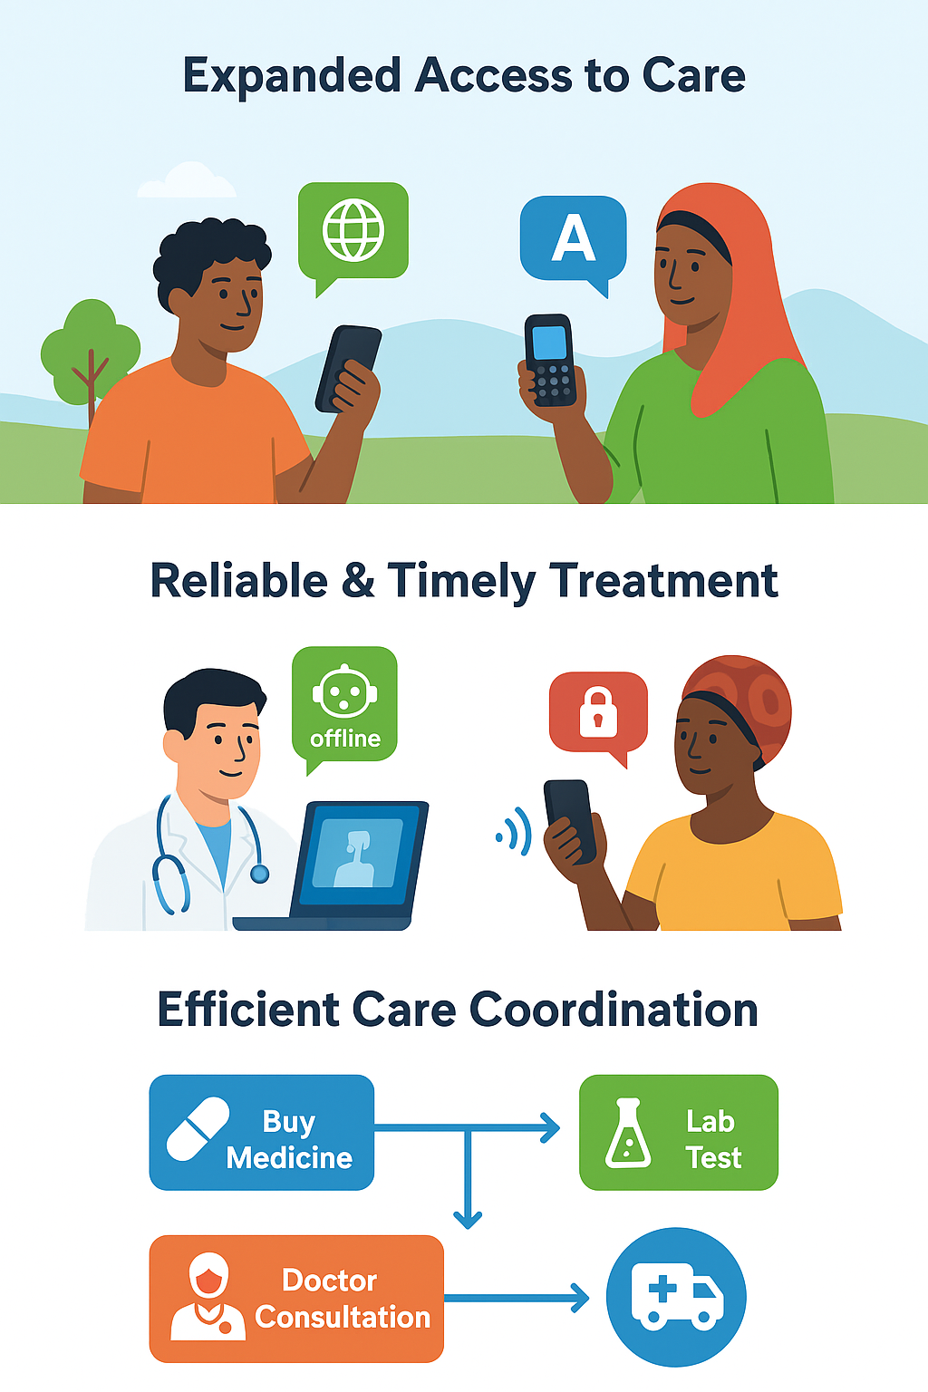
IMPACT AND BENEFITS
SEHAT SYNC
Potential impact on the target audience:
Expanded Access to Care: Multilingual support, icon-based navigation, and SMS/USSD make healthcare reachable
for low-literacy users and those without smartphones.
Reliable and Timely Treatment: Offline AI triage, encrypted health records, and adaptive streaming ensure
smooth consultations and uninterrupted care—even in low-connectivity zones.
Efficient Care Coordination: Real-time medicine tracking and integrated lab booking reduce delays, minimize travel,
and improve treatment adherence.
Benefits of the solution:
Social benefits:
Improves healthcare access for underserved, low-literacy, and remote populations
Promotes inclusive care through multilingual support and voice-assisted navigation
Empowers individuals with offline tools for symptom checking and health record access
Reduces delays in diagnosis and treatment, improving overall health outcomes
Economic Benefits:
Cuts down travel costs and time by enabling remote consultations and local medicine tracking
Supports early intervention, reducing long-term healthcare expenses
Boosts efficiency for clinics, pharmacies, and labs through real-time coordination
Encourages better resource utilization and reduces system overload
Environmental Benefits:
Lowers carbon footprint by minimizing unnecessary travel for appointments and medicine
Promotes digital health records, reducing paper usage and waste

Slide 7
RESEARCH AND REFERENCES
SEHAT SYNC
Details / Links of the reference and research work:
IJSDR2508203.pdf
Addresses communication gaps in healthcare caused by language barriers, especially in multilingual regions like India, Southeast Asia, and Africa.
Aims to reduce misdiagnosis, improve patient engagement, and enhance treatment adherence by making healthcare communication more inclusive and intelligent.
Frontiers | Bridging language barriers in healthcare: a patient-centric mobile app for multilingual health record access and sharing
Improve healthcare accessibility and communication by enabling patients to access and share their health records in multiple languages—especially useful when seeking care across borders.
Chatbot for Multilingual Healthcare Environment Using Bio-BERT
Aims to simplify healthcare communication for rural and underserved populations by using an AI-powered chatbot that understands and responds in multiple languages.

